Slide 1


WEB PROGRAMMING
TOKEN MANAGEMENT SYSTEM
Presented By:
SHWETHIN
TEJASSH
STEVE IPE
NIKHIL STALIN
NOEL DENNY
TALAHA

Slide 2
01
PROBLEM
STATEMENT
Traditional queue systems often involve:
  Manual registration and paper-based tokens
  Long physical waiting times
  Difficulty managing large queues
  Errors in token allocation
  Duplicate token numbers during simultaneous registrations
  No simple way for attendees to join remotely

Slide 3
02
PROPOSED
SOLUTION
01
Organizer creates event → QR code is generated
QR BASED DIGITAL TOKEN SYSTEM
02
Attendee scans QR → Enters name
03
Receives unique token → Organizer manages queue

Slide 4
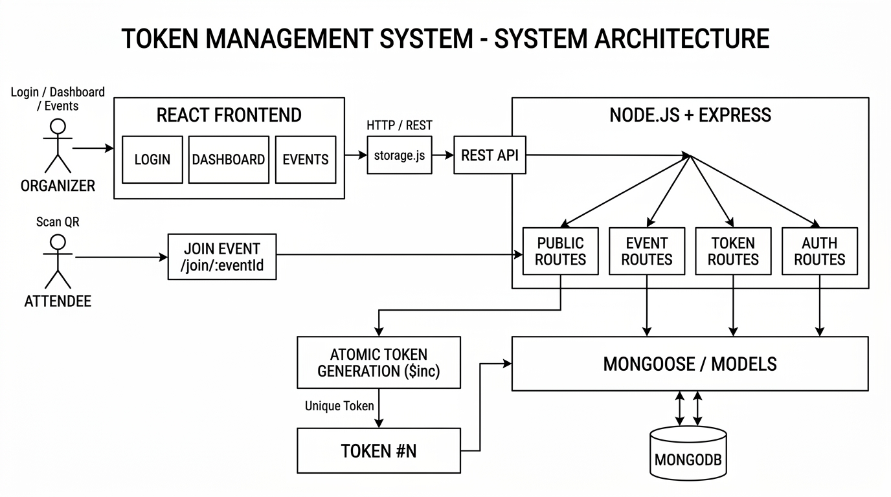

Slide 5

TECHNOLOGIES USED
Frontend
  React.js — Component-based user interface
  React Router — Page navigation and routing
  Vite — Development and build tool
  JavaScript — Application logic
  localStorage — Stores JWT on the client
Backend
  Node.js — Server-side JavaScript runtime
  Express.js — REST API framework
  Mongoose — MongoDB object modeling
  bcryptjs — Password hashing
  jsonwebtoken (JWT) — Authentication
Other Technologies
  MongoDB — Database
  CORS — Cross-origin communication
  dotenv — Environment variables
  mongodb-memory-server — Embedded database fallback
04

Slide 6
REACT
IMPLEMENTATION
MAIN COMPONENTS
  App.jsx — Defines application routes
  Login.jsx — Organizer login
  Register.jsx — Organizer registration
  Dashboard.jsx — Displays organizer events
  ManageEvent.jsx — Event and queue management
  JoinEvent.jsx — Attendee token generation
  storage.js — API communication and JWT handling
05

Slide 7
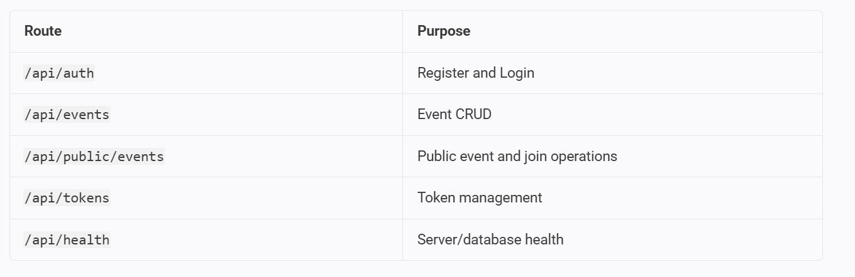
NODE.JS & EXPRESS.JS IMPLEMENTATION
MAIN RESPONSIBILITIES
  Starts the Express server
  Connects to the database
  Configures CORS and JSON middleware
  Mounts API routes
  Provides /api/health endpoint
  Handles database fallback modes
API ROUTES
06

Slide 8
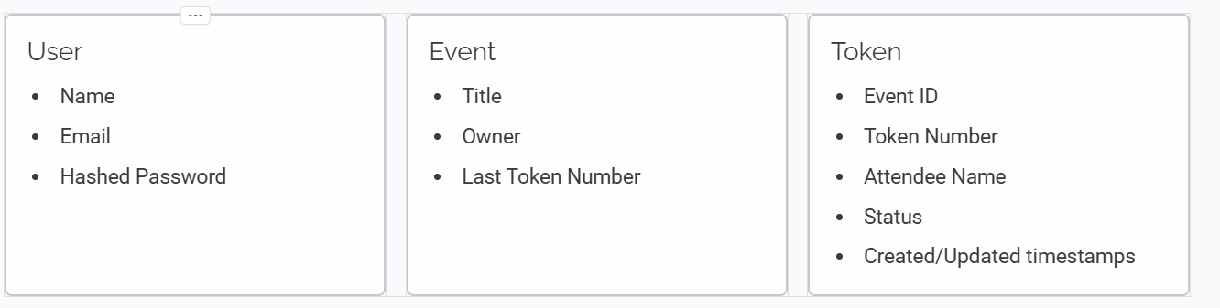
DATABASE DESIGN & CRUD OPERATIONS
Database Design
The system uses three main models:
CRUD OPERATIONS
Events:
Tokens:
  Create event
  Read events
  Update event
  Delete even
  Create token through public join
  Read/list tokens
  Update token status
07
Token Status
waiting → done

Slide 9
08
MEMBER 1
MEMBER 2
Dashboard, Event Management & QR Code
React routing, Login & Registration
MEMBER 3
INDIVIDUAL CONTRIBUTIONS
MEMBER 4
Attendee Join Flow & Public Token API
JWT Authentication & Security
id eiusmod ex adipisicing reprehenderit eiusmod veniam velit deserunt nisi eu anim non qui esse mollit et nisi deserunt anim consequat
MEMBER 5
MEMBER 6
Event Backend & Database Operations
Token Backend, Atomic Token Allocation & Server Setup

Slide 10
09
  Organizer Registration Account created
  Organizer Login JWT generated
  Create Event Event stored
  Generate QR Join URL generated
  Scan QR Join page opened
  Attendee Join Unique token generated
  Multiple simultaneous joins Unique token numbers
  View Tokens Queue displayed
  Mark Token Done Status updated
  Health Check
  GET /api/health
TESTING & RESULTS
FUTURE PLANS AND ASPIRATIONS

Slide 11
10
  Conclusion
  Developed a digital queue management system using QR codes.
  Organizers can create and manage events.
  Attendees can join queues without creating an account.
  JWT provides secure organizer authentication.
  bcryptjs protects user passwords.
  MongoDB stores users, events and tokens.
  Atomic $inc ensures unique token allocation during concurrent joins.
  Fallback storage makes the system suitable for demonstrations.
  Future Scope
  Real-time queue updates using WebSockets / SSE
  Live waiting-time and queue-position display
  Push/SMS notifications
  Pagination and search for large queues
  Role-based access control
  Analytics and queue statistics
  Rate limiting and stronger authentication
  Password reset and refresh-token support
CONCLUSION & FUTURE SCOPE
CONCLUSION

Slide 12
THANK YOU

